Slide 1
To Fix Our Ailing Economy, Start By Fixing Our Decaying Infrastructure

Slide 2
In the last 2 issues of “E-News,” we have covered important points on the U.S. economy. We discussed:
America is not broke. Our GDP, corporate profits, and corporate value are at record levels.
However, working families aren’t getting their fair share. It’s our productivity that is fueling economic growth, but the payoff is going to CEO’s, banks, insurance companies, and institutional investors.
In fact, earnings for working families are stagnant or in decline.
There are 23 million Americans unemployed, and millions of others working full-time for less than poverty level wages.

Slide 3
Working families are also being burdened with a larger portion of the tax bill. So, it’s not bad enough that we aren’t getting a share of the wealth we create; we are also paying out more, and more, and more.
Combine the facts that corporations and the top income earners are not paying their fair share in taxes, and millions of Americans are either unemployed or working for less than poverty wages, and therefore unable to pay any taxes. Is it a surprise that America is in economic crisis?
In this week’s issue of E-News, we would like to begin to review the consequences of this failing policy.
With corporations and the wealthy elite contributing less in tax revenue, and millions of working families unable to contribute, HOW ARE WE GETTING BY?
ANSWER: WE BORROW

Slide 4
National Debt
Dollars in Trillions
Source: Business Insider 1-11-11. Update 1-1-13 National Debt Clock

Slide 5
As a nation, we have a total accumulated national debt of $16.5 trillion dollars.
The consequence of having such a huge national debt is that there aren’t sufficient funds available to support the needs of society.
One of our most serious failings is the condition of the U.S. infrastructure.
All experts agree that in order to compete in a global economy during the 21st Century, our country needs to invest heavily in infrastructure and educational systems.
The only way out of the debt crisis that we find ourselves in, is to “grow” the economy.
So, why don’t we do both?
Fix the debt crisis by putting people back to work,
and,
Allow America to compete by rebuilding our infrastructure.

Slide 6
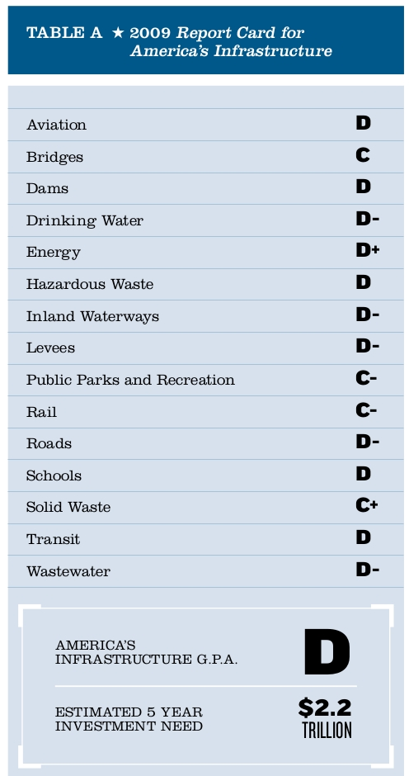
How does the U.S. infrastructure grade out?
In it’s last report in 2009, the American Society of Civil Engineers graded us with a “D.”

Slide 7
One of the key signs that we are in the early stages of an economic collapse and that we may be tumbling toward another Great Depression is America's crumbling infrastructure.
The truth is that our infrastructure is literally falling apart all around us.
Thousands of bridges are structurally deficient, and there have already been some very high profile collapses. Over 30 percent of the highways and roads in the United States are in very poor shape.
Aging sewer systems are leaking raw sewage.
Fresh water pipes leak.
The power grid is straining to keep up with the ever-increasing thirst of the American people for electricity. There have already been regional blackouts, and unless something is done quickly things promise to get even worse.
When these problems exist with the performance of infrastructure, the effects are devastating.

Slide 8
If our infrastructure problems are not addressed, power outages will become more frequent, prices at the store will inch up, drinking water will be less accessible, traffic will be forced to detour around bad bridges, household incomes will drop, and millions of people will lose their jobs.
The U.S. became a global economic super power in large part because of the efficient infrastructure we developed during the 20th Century.
We are now faced with critical issues relating to aging infrastructure that threaten our future economic security, and our quality of life.
Corporations that seek expansion, relocation, or consolidation generally place infrastructure assets at the top of the list when deciding where to locate.
If America is to compete during the 21st Century, re-building our infrastructure must be at the top of our list of priorities.
Our current state of decay CANNOT BE ACCEPTABLE !
The truth is, our nation’s infrastructure says a lot about who we are. So, what does America’s infrastructure say about us? It says that we are a rusting, crumbling, decaying leftover from a better, more prosperous time.

Slide 9
Infrastructure Spending as a Percentage of GDP

Slide 10
We are quickly falling behind the rest of the world.
Increasingly, a group of rising economies – from Brazil to the United Arab Emirates – is building the showcase projects that once were mainly the pride of the U.S., Western Europe, and Japan.
America's Hoover Dam made headlines in the 1930s; today, it is China's $25 billion Three Gorges Dam.
Half of the 30 most expensive projects globally are in China, Brazil, the Middle East, and other parts of the developing world.
And, “big-ticket” items aren't confined to the developing world. Britain's plan to spend 100 billion pounds ($132 billion) on offshore wind farms is the second priciest project on a list compiled by the AP, followed by Japan's 5 trillion yen ($62 billion) Daini Tomei Highway.
While U.S. states are talking about high-speed rail, China is set to double its network – already the world's longest – to 16,000 kilometers (10,000 miles) by 2020.

Slide 12
Infrastructure spending projections include both the cost of building new infrastructure, and for maintaining or rebuilding existing infrastructure that needs repair.
The total cumulative gap between projected needs and likely investment in these critical systems will be $1.1 trillion.
Overall, if this gap is not addressed by 2020, the economy is expected to lose almost $1 trillion in business sales, resulting in a loss of 3.5 million jobs.
Moreover, if current trends are not reversed, the cost to the U.S. economy from 2012 to 2020 will be more than $3.1 trillion in GDP and $1.1 trillion in total trade.
As time goes on, it will only get worse. If we don’t give infrastructure spending a greater priority by 2040 (just 27 short years), the gap between what is needed and what is likely will grow to $4.6 trillion.

Slide 14
Our system of power generation, transmission, and distribution facilities was built over the course of a century. Centralized electric generating plants with local distribution networks were started in the 1880s, and the grid of interconnected
transmission lines was started in the 1920s.
Today, the U.S. system is a complex patchwork system of regional and local power plants, power lines, and transformers that have widely varying ages, conditions, and capacities. Many utility companies have structures that have been running for 50 to 70 years.
In summary, utility customers are in many cases paying first-class rates, but receiving third-world services.
In addition, over the past 15 years utility companies have slashed their workforces – even as workloads increase. Therefore, there is greater demand to maintain our aging systems.
Case in point: Following Hurricane Sandy, Utility Workers in the northeast were engaged working 24/7 to restore service to the millions affected by the storm.

Slide 15
Utility companies need to step up and address the human and physical infrastructure issues that threaten our communities.
Investment is needed to upgrade our generation, transmission, and distribution systems.
Utility companies need to maintain a skilled full-time staff, and not rely on the availability of contractors or mutual aid workers.
Public Service Commissions should become more engaged utility regulators and hire sufficient staff to handle oversight and utility audits.
All utility companies should be required to maintain annual maintenance plans and budgets that ensure our systems stay reliable.
Discussions on these important issues need to be taking place in each of our communities BEFORE the next crisis hits.

Slide 17
Delivery of water and wastewater services in the United States is decentralized and strained.
Approximately 54,000 drinking water systems collectively serve more than 264 million people (more than half the nation’s public drinking water
systems serve fewer than 500 people).
In addition, almost 15,000 wastewater treatment facilities and 20,000 wastewater pipe systems are spread across the U.S.
Although access to centralized treatment systems is widespread, the condition of many of these systems is also poor, with aging pipes and
inadequate capacity leading to the discharge of an estimated 900 billion gallons of untreated sewage each year.
As the U.S. population has increased, the percentage served by public water systems has also increased. Each year new water lines are constructed to connect more distant dwellers to centralized systems, continuing to add users to aging systems.

Slide 18
Although new pipes are being added to expand service, drinking water systems degrade over time.
Failures in drinking water infrastructure can result in water disruptions,
impediments to emergency response, and damage to other types of essential infrastructure.
Water related infrastructure in the United States is clearly aging, and investment is not able to keep up with the need.
By 2020, the predicted deficit for sustaining water delivery and wastewater treatment infrastructure will be $84 billion. This may lead to $206 billion in increased costs for businesses and households between now and 2020.
In a worst case scenario, the U.S. will lose nearly 700,000 jobs by 2020, and unless the infrastructure deficit is addressed by 2040, 1.4 million jobs will be at risk in addition to what is otherwise anticipated for that year.

Slide 20
Our transportation infrastructure includes the critical highways, bridges, railroads, and transit systems that enable people and goods to access the markets, services, and inputs of production that are essential to America’s economic vitality.
For many years, the nation’s transportation infrastructure has been deteriorating.
Continued deterioration of our transportation system leaves a significant and
mounting burden on the U.S. economy.
Nationally, for highways and transit, 630 million vehicle hours traveled were lost due to congestion in 2010. This total is expected to triple to 1.8 billion hours by 2020 and further increase to 6.2 billion hours in 2040. These vehicle hours understate person hours and underscore the severity of the loss in productivity.
In 2010, it was estimated that deficiencies in America’s surface transportation systems cost households and businesses nearly $130 billion.

Slide 21
If we want to fix an ailing economy, why not start by fixing our decaying infrastructure?
A 5 year, $1.2 trillion infrastructure investment program would create 23,000 jobs for every $1 billion of investment.
That would create 5.52 million jobs in each year of the 5 year program, or 27 million jobs.
The U.S. economy relies on low transportation costs and the reliable delivery of clean water and electricity to businesses and households.
It’s time to fix it!

