Slide 1
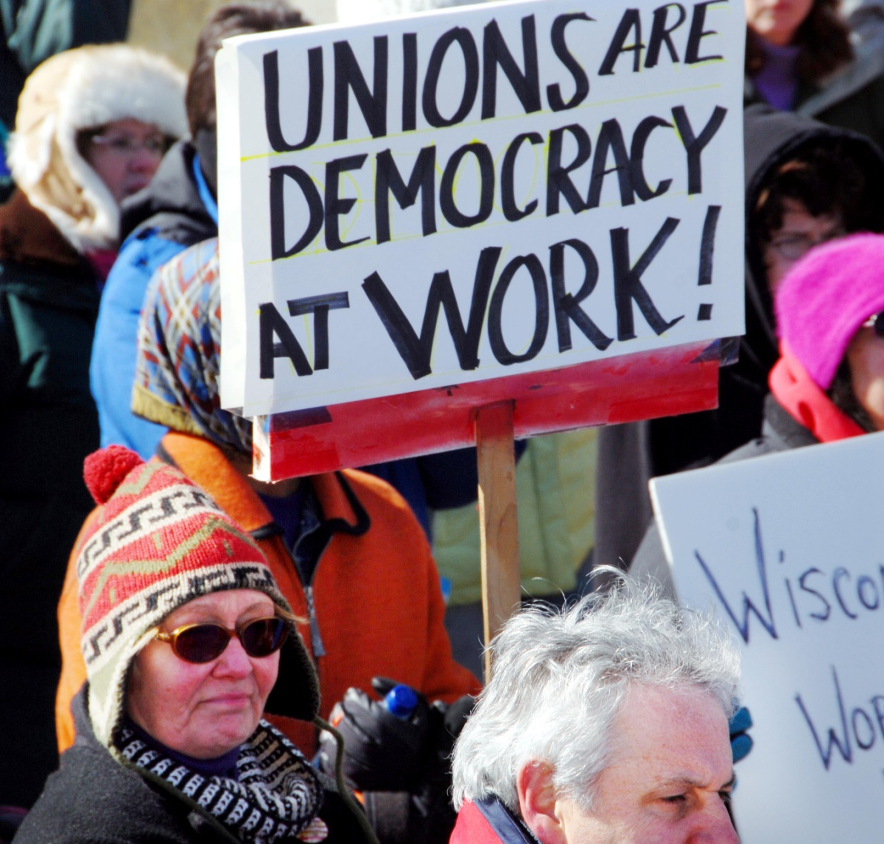
How Has America Changed?
Union Density and Politics

Slide 2
In the last several editions of the Utility Worker E-News, we discussed changes that have taken place in the U.S. economy over the past few decades:
As a nation, we are still extraordinarily profitable.
U.S. corporations are experiencing record shareholder value and set new records of profitability each year.
American CEOs and the wealthiest 1% of the population have never done better.
Shifts in our tax policies have placed a larger burden on working families.
Middle and low income earners struggle to make ends meet.
Our future is threatened by an enormous accumulated national debt.
Our failing national infrastructure and declining educational system threatens our ability to compete globally.
SO, HOW COULD ALL THIS HAPPEN ?

Slide 3
HOW HAS AMERICA CHANGED?
A strong Democracy requires active civil engagement.
The cornerstone of the American political system has always been the personal involvement that encourages debate, that fosters good decision making.
In today’s fast paced busy world, we have disengaged from political involvement.
America has become a society made up of separate, isolated individuals rather than organic, integrated communities.
Studies show decreased voter turnout (especially mid-term elections), declining public meeting attendance, fewer people serving on committees or working with political parties, and less personal activism in their union, church, community group, or fraternal organization.
There is also a serious growing distrust in government.

Slide 4
One hallmark of the first 30 years after World War II was the “countervailing power” of labor unions and their ability to raise wages and working standards for members and non-members alike.
As union membership grows, the distribution of wealth becomes more equal.
High union membership makes a difference not only at the bargaining table, but the corresponding political power raises incomes in both the union and non-union sectors. In short, high tides raise all boats …… low tides lower all boats.
It’s no coincidence that the two periods of time when the distribution of wealth was most unequal, union membership was also at the lowest. This occurred in both 1927 and again in 2007.
It’s really pretty simple, fewer union members = less power.
And, POWER = JUSTICE. The more power you have, the more justice you can expect to receive.

Slide 5
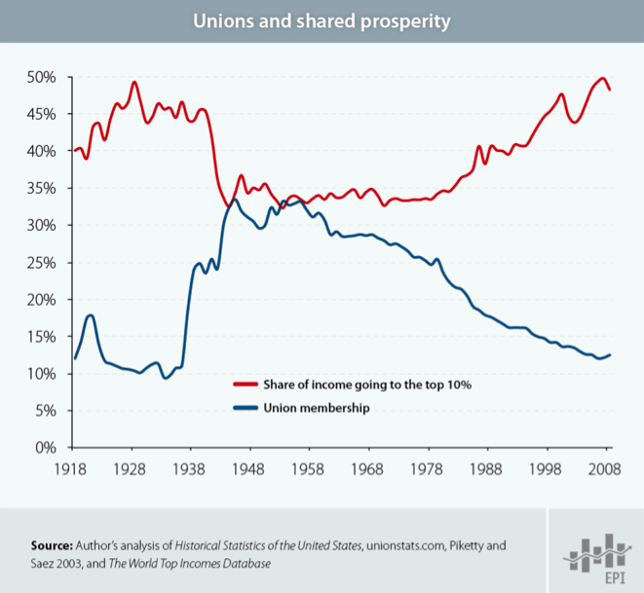

Slide 6
In 1959, Wisconsin became the first state to grant collective bargaining rights to its public workers.
The next half-century witnessed the rise of public sector unions. As union density declined in the private sector, it increased in the public sector.
Today, 7.8 million public sector employees belong to a union as compared to 7.0 million private sector employees.
The fortune of public sector unions and their members turned on a dime with the 2010 mid-term elections.
Over the last two years, we have witnessed some of the most harmful attacks on public employees and their unions in the past half-century.
Why? If the wealthy elite can get away with stripping public sector employees of their rights to organize and bargain, the organized labor movement would continue to decline and so, too, would our power.
Therefore, it’s easy to understand why folks like Richard DeVos or the Koch Brothers will spend tens of millions of dollars to sustain attack on unions.

Slide 7
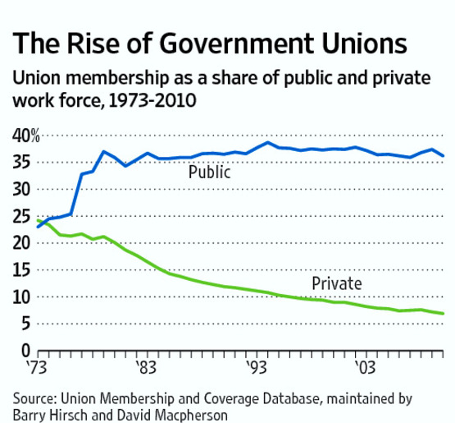

Slide 8
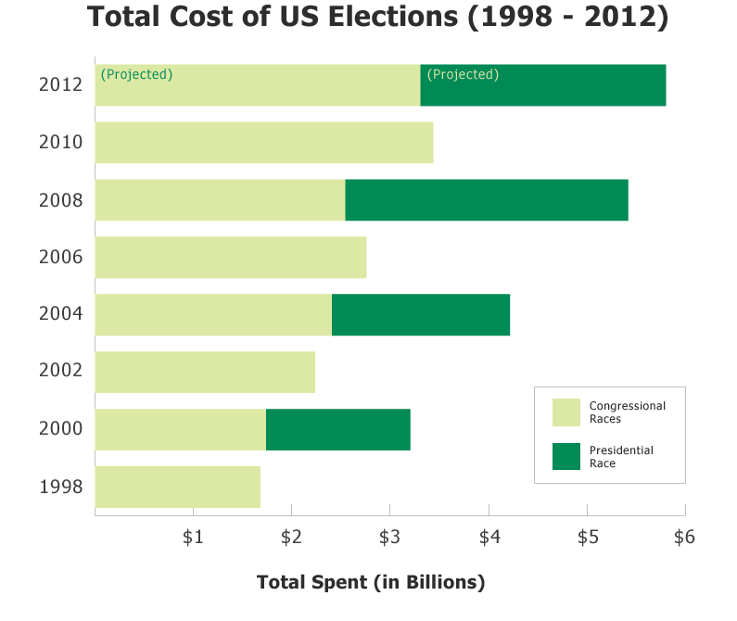

Slide 9
Unions and Democracy
A report by the Center for Responsive Politics places the total cost of the 2012 elections at an estimated $6 billion, which would make it the most expensive election in U.S. history.
President Obama and Republican presidential nominee Mitt Romney both rejected federal public financing – another first – and each of them collected nearly as much as the entire field in 2004.
That’s largely because many of the Watergate-era laws limiting campaign money have been nullified or circumvented. The 2012 presidential election cycle marks the first since Citizens United, the Supreme Court ruling that swept away key restrictions on money from corporations and the wealthy.
Today, one wealthy donor can finance the entire advertising for an independent group in a particular Senate or House race.
Since 1998, the amount of money spent on lobbying to influence public policy has doubled ($1.4 billion compared to today’s 3.3 billion), and the number of paid lobbyists has grown from 10,000 to over 12,000.

Slide 10
Unions and Democracy
And, it’s not just the cost of elections -
There are two main ways that groups of people can systematically influence politics in a democracy—one is based on the willingness to pay and the other is the willingness to act. Corporations and wealthy individuals can affect politics through the first. Unions are one of the main ways for facilitating the second.
The decline of unions removes the important associational basis for a coherent working class voting population.
With less people willing to act, those willing to pay have a greater influence on political outcomes.

Slide 12
Unions and Democracy
Unions do far more than negotiate wages and benefits for their own workers. Unions have fought to strengthen public policies that benefit all Americans, unionized and non-unionized. And, as corporate power and influence skyrockets, unions can provide a powerful mechanism for voter turnout that keeps our democracy strong.
Unions not only counteract the tendency for people to act in individual ways that fuels political apathy; unions help foster political identities in class terms.
A strong union movement is essential both for increasing the political engagement of workers, and for that engagement to have a distinctively working class character.
Unions have fought to strengthen public policies that benefit all Americans. Unions fight to strengthen minimum wage laws, worker safety protections, and public safety nets such as Social Security and Medicare. We have unions to thank for the two-day weekend and the 40-hour workweek.

Slide 13
Unions and Democracy
The decline in unions not only affects people’s political identities, it affects political parties’ responsiveness to working class issues. Both the Democratic Party and the Republican Party have to seek support from the wealthy and corporations due to the cost of election campaigns.
This shift in balance (between higher union density with greater working class participation in the electoral process versus agendas for the very wealthy and corporations) has moved both political parties’ agendas away from a government centrally focused on inequality, poverty, and urban development to an aversion to taxation of the wealthy and a focus on much more relaxed regulation of the market.
Our challenge is not only in sustaining our current power, but building even greater power to fight for justice for all working families.
In next week’s issue, we will begin to explore a strategy for the future.

