Slide 1
Power = Justice
The amount of power we have will determine the amount of justice we can expect to receive.

Slide 2
History has shown that the amount of power workers have is proportional to the amount of justice they can expect to receive.
When we have a little bit of power ………. we only win a little bit of justice.
It’s when workers and their unions have awesome power that union members win awesome justice.
It’s no coincidence that when labor was at its peak of power in the 1950s, 60s, and even into the 1970s, labor unions made great advances in winning legislation that supported the needs of working families, and we were able to bargain quality contracts. As the old labor adage goes, “The ballot box is tied to the bread box.”
Strong unions have reduced the stark income inequalities in this country.
Likewise, as the amount of union density and public support diminished, so did progress in securing legislative protections and income equality.
So, how do we rebuild our power?

Slide 3
Power = Justice
The amount of power we have will determine the amount of justice we can expect to receive.

Slide 4
Our power comes from 3 distinct sources:
a. Having high union density! The more workers who belong to unions, the greater power the labor movement has.
b. Building broad public support. At our peak of power, union membership reached 35%. That means that 65% of American workers did not belong to a union. However, the important lesson we learned is, we win justice when a large majority of American families believe that unions represent the interests of ALL WORKING FAMILIES. In short, although union membership is important, so is the faith of all workers (union and non) that unions make a difference in their lives.
c. Demonstrating that labor is relevant in our political process. Union members vote, and equally important is our ability to influence candidates with our personal activism. Union members running for public office, helping to turn out the vote for candidates, raising campaign contributions, and participating in the political process at all levels is what wins elections; and makes unions relevant within our democracy.
If we want to build awesome power, we must increase our percentage of density, engage with the broader community, and be a meaningful voice in the democratic process.

Slide 6
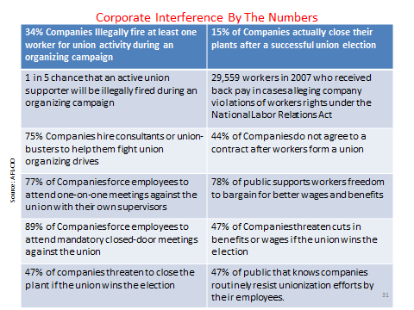

Slide 7
Our Path to Power – Build Union Density
Current labor law was established in 1935, and hasn’t been improved since then! The law is outdated and doesn’t protect workers’ rights to organize and engage in collective bargaining. Current law:
Consists of outdated laws and failed processes.
Is more favorable to business than it is for workers.
Allows employers to violate workers’ rights, and engage in firing workers.
Allows employers to routinely hold private one-on-one intimidating conversations with workers.
Permits the discharge of union organizers with minimal risk for penalty.
Tolerates threats of job loss.
Must be changed to allow workers their democratic right to organize, free of intimidation, threats, and firing. High union density protects our rights to bargain fair contracts for UWUA members, and protects our jobs from erosion by non-union contractors, and other non-union employers.

Slide 8
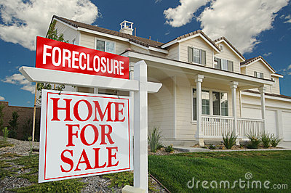
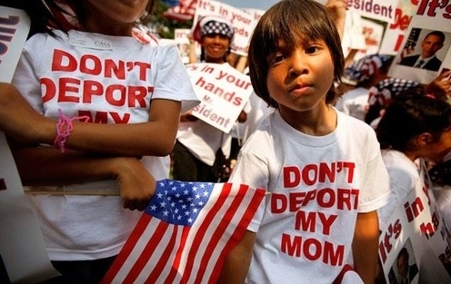

Slide 9
Our Path to Power – Support ALL Working Families
Unions need to demonstrate that we represent the 99% !
Since 2008, over 8 million families have been evicted in foreclosure proceedings as a result of predatory lending, fraud, and corruption in mortgage banking practices. A corresponding effect of foreclosure has been the devastation of all of our home values. Homes are the most important financial resource working families possess. We can support all working families by standing up against the banks, halting foreclosures, and keeping our communities intact.
1.7 million young immigrants who came to the U.S as children are threatened with deportation. We need a responsible immigration policy that protects our borders, but also one that supports expedited citizenship for millions threatened by deportation who have been responsible, tax-paying citizens for years. Unions must stand for human rights for all.
In a $16 trillion economy, 1 out of every 5 American children either go to bed or school hungry every day. That’s just WRONG!
What’s more important than Jobs, Shelter, Justice, and Food? Unions need to be seen as a fighter for justice for all.

Slide 10
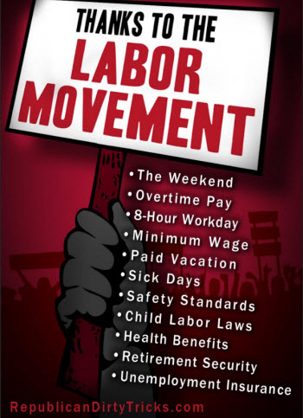

Slide 11
Our Path to Power – Political and Legislative Activism
Who created workers compensation, overtime premiums, safe work practices, unemployment benefits, minimum wage, public roads/education, employer paid health care, and a middle class standard of wages? Of course, it was unions.
That is exactly why America’s wealthy elite want to do away with them: Unions are the only institutions that speak out for fairness, and demand transparency and accountability.
It’s our voting power that represents a democratic balance for debate. Unions create a more vibrant society through worker participation in the political process.
It’s our activism that elects public officials who support working family needs and keeps government authority in check.
It’s our money that counters the massive financial contribution of the elite and their quest for unbridled power.
It’s our ability to influence the political process that working families count on!

Slide 12
Member Engagement Critical to Our Future

Slide 13
Recognize Today’s Crisis & Fight For a New Vision:
Not temporary, isn’t normal, not fate
SYSTEMIC
Develop Local Union Plan of Action
Identify a fight for justice within your community
Educate, Organize, & Mobilize
Organize the Unionized
1 on 1 Communication
Celebrate a Fair America

Slide 14
Our Path to Power – Personal Engagement of Each and Every Member
UWUA was organized through personal sacrifice, dedication, and commitment to achieve justice.
Our union is directly responsible for the quality of life that tens of thousands of our members, retirees, and families enjoy today.
If we are going to sustain our hard fought benefits and gains, we need to return to a high level of personal activism and engagement.
Our key to success is improved education and communication.
America is currently mired in the devastating economic crisis which we have discussed over the past several issues of E-News. However, we are still the greatest country on earth and there is plenty of reason for optimism for our future.
If we are to keep America strong, we need to build a social justice movement not seen in this country since the 1930s.
That means a greater understanding of the issues, and a personal commitment for increased involvement from all of our members.

Slide 15
The first step in winning justice is for us to recognize that today’s crisis isn’t temporary. It also isn’t normal, and isn’t “fate. Our crisis is systemic -- it’s the result of the policies and priorities that we choose to practice.
Einstein defined insanity as: Doing the exact same thing, the exact same way, and expecting different results. If we want a different result, we need to do things differently. And, that means developing a plan for the future, including greater member involvement and personal activism.
Our plan for the future starts with personal engagement.
We are in the process of implementing a “Member to Member Action Network” Pilot in each of our Michigan Local Unions.
As we perfect our process, we plan to expand throughout the union.
The Member to Member Action Network focuses on improved understanding and relationships, and starts with an open, two-way regular communication system.
Here is how it works:

Slide 16
UWUA Internal Organizing Plan
Step 1
Commitment from Top Leadership
Step 2
Assign Program Controller
Step 3
Design Program Structure
Step 4
Map Workplace
Step 5
Assign Member Action Coordinators
Step 6
Recruit Member Action Organizers
Step 7
Assign Members to Member Action Organizers
Step 8
Educate Member Action Organizers
Step 9
Pilot Contact
Step 10
Calendar of Activities

Slide 17
Top Local Union Leadership commits to a new process of education and communication. We will certainly continue to service the needs of our membership through collective bargaining and grievance handling, but we recognize that we need to do more. Engaging in regular face to face conversations that include two-way communication is our goal.
Each local will designate one person to be responsible for the local union Member to Member Action Network. This will normally be the Local Union President, although someone else may be asked to serve in this capacity.
A structure and system will be developed to foster this Member to Member approach.
To ensure each and every member is contacted, we will identify by name each member -- where they work, when they work, and who they work with.
For large local unions, a coordinator of the program will be designated for each shift and physical work location.

Slide 18
Member to Member Action Network
Local Union Leadership
Local Union President or Designee
Member Action Coordinator
One per unit / building / work location
Member Action Organizer
(contacts 5 - 20 co-workers)
Member
Member
Member
Member

Slide 19
Member Organizers will be designated and trained. It is these individuals who will be responsible for making regular contact with the membership. In many cases, this will be our Stewards, assisted by other union activists as necessary.
Each organizer will be given the assignment to have regular communication with 10 to 20 co-workers. The communication will include 3 steps:
Providing education and/or information to the member about important issues facing our union.
Soliciting the member’s opinion on the issue being discussed, and listening to the member’s suggestion for union policy.
Asking the member to take personal action.
We plan to have at least one contact each month.
As we proceed with our new communication process, we will always strive to improve the process.
Our goal is to put the U back into the UNION!

