Slide 1
Education – The “other” Core Infrastructure Investment

Slide 2
In the last few issues of E-News, we have explored serious economic issues impacting all of our families.
The United States is still the world’s economic “Super Power.”
By far, we outpace others in GDP, worker productivity, corporate profits, shareholder value, and executive compensation.
However, middle and low income earners have lost significant ground. These groups have lost both income and share of this nation’s wealth.
To make matters worse, they also see their share of the tax bill increasing.
Can an economic policy that benefits a few at the expense of the many survive in today’s “Global Economy”? Not Likely.
The International Monetary Fund (IMF) projects that China’s economy will be bigger than that of the United States by 2016. That is just three years away, and it will be the first time in more than a century that the United States will no longer be the world’s largest economy.
Historically high and chronic unemployment continues to slow our path to recovery.

Slide 3
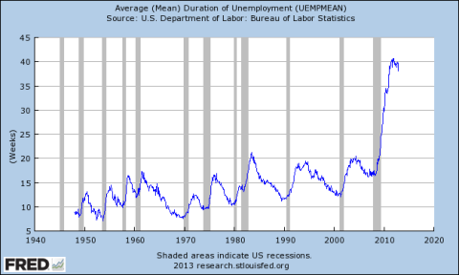

Slide 4
Long term unemployment and underemployment is at the highest level since at least the end of World War II, threatening to create a permanent underclass of workers who will find it difficult, if not impossible, to obtain jobs in the future.
According to data recently released by the St. Louis Federal Reserve, the average duration of unemployment is now at about 40 weeks, double the previous highest level of about 20 weeks that prevailed during the last three recessions.
Creating jobs -- GOOD jobs should be the number one focal point guiding all of our policy debate. It’s the only way for the economy to recover.
After all, if the 23 million currently unemployed workers were receiving a paycheck, they could buy things, and thus fuel a full economic recovery.
Not to mention that they would also be able to pay taxes and thus help pay down our tremendous national debt that costs billions of dollars in interest payments, and robs the economy of otherwise productive uses.
Last week we reviewed the need to rebuild America’s crumbling physical infrastructure.
Another important infrastructure needed to sustain our ability to compete globally is meeting our EDUCATIONAL needs.

Slide 5
Percentage of Age 25 - 34 With a College Degree

Slide 6
China and India are expanding their influence in the higher education arena.
About 40 percent of young post-secondary degree holders in leading countries will come from China and India by 2020. The United States and the European Union countries combined will produce about 25 percent.
The gap between China and the United States -- the two leading producers of graduates in 2010, with 18 and 14 percent respectively -- will grow even larger by 2020. China is expected to produce 29 percent of all higher education graduates.
In 2009, the United States established a goal to become the global nation with the highest proportion of 25-34 year old graduates by 2020. According to a report published on this, about 60 percent of the target group must attain a post-secondary degree in order to reach this goal.
China is also looking to educate more people by 2020. It is aiming for 20 percent of its citizens, or 195 million people, to have higher education degrees by the end of this decade. According to the report, this would mean that China’s population of higher education graduates would be about the same as the entire projected population of 25-64 year olds in the United States in 2020.

Slide 7
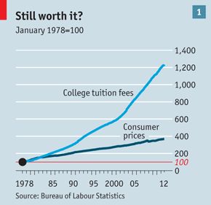
Cost of Higher Education Soars 1200% in 30 Years

Slide 8
A primary cause of the declining numbers of college graduates may be the fact that soaring tuition and shrinking incomes are making college less and less affordable.
For millions of young people, rising college costs are putting the American dream on hold, or out of reach.
In the 1970s, the maximum Pell Grant for low-income families covered 40% of private tuition. Today, it covers only 15%.
For public universities, the value has dropped from 60% to 40%.
According to the College Board, the volume of student loans has grown at an average of 27% per year since 2001.
As tuition costs continue to soar and the national student loan debt hits $1 trillion, many people have been left wondering if college is even worth it anymore.

Slide 9
Therefore, lowering college costs must be a priority for the whole country.
Education Secretary Arne Duncan notes: "As a nation, we need more college graduates in order to stay competitive in the global economy, but if the costs keep on rising, especially at a time when family incomes are hurting, college will become increasingly unaffordable for the middle class.”
As a nation, we are experiencing widening gaps in skill levels, wage levels, and demographic shifts of more people with less education and fewer skills.
If we don’t confront these changes, we will find it difficult, if not impossible, to maintain a vibrant middle class.
The American dream of decent jobs and livable wages could disappear in our lifetime.

Slide 10
Number of People Living in Poverty in the U.S. 1959 – 2010
Number in millions – Rate in percent
49.7 million
Number in poverty (in millions)
15 percent
Poverty rate
Source: U.S. Census Bureau as reported by Business Insider 9-16-10. 2012 poverty number updated CBSDC/AP 11-15-12.2012 Poverty Rate updated Washington Times 9-12-12

Slide 11
Of course, in order to get to college you must first have K-12 education.
A weak economy also has a direct impact on the potential for America’s youth to make that transition.
In 2012, 49.7 million Americans were living in poverty. That equates to 15% of the population of the United States.
Children living in poverty have a higher level of absenteeism or leave school altogether because they are more likely to have to work or care for family members.
As a group, 16 to 24 year old students who come from low income families are seven times more likely to drop out than those students from families with higher incomes.
A higher percentage of young adults (31 percent) without a high school diploma live in poverty, compared to the 24 percent of young people who finished high school.

Slide 12
Rigorous research has demonstrated that investments in both educational facilities and in providing high-quality pre-kindergarten education would yield extraordinary returns. Each $1 spent improving marginal educational facilities leads to $1.50 in economic value. Even more striking, investments in universal high-quality pre-kindergarten education can carry eventual benefit-to-cost ratios as high as 8-to-1.
According to the University of Michigan sponsored National Poverty Center's statistics, "Children represent a disproportionate share of the poor in the United States; they are 24% of the total population, but 36% of the poor population. In 2010, 16.4 million children, or 22%, were poor."

Slide 13
40 percent of all children living in poverty aren’t prepared for primary schooling.
Children who live below the poverty line are 1.3 times more likely to have developmental delays or learning disabilities than those who don’t live in poverty.
On average, by the end of the 4th grade, African-American, Hispanic and low-income students are already two years behind their grade level. By the time they reach the 12th grade, they are four years behind.
Less than 30 percent of students in the bottom quarter of incomes enroll in a four-year school. Among that group, less than half graduate.
And, of course; we need talented teachers to help lead the way.

Slide 14
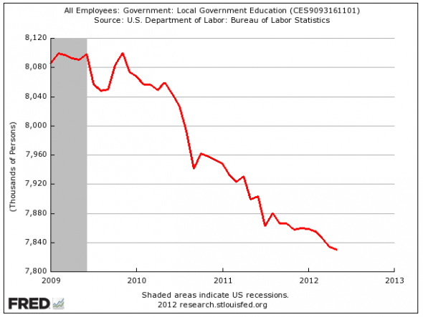

Slide 15
Since June 2008, when local governments employed 8.1 million teachers, more than 300,000 teachers have been laid off. And, those still working are making less.
The truth is that in a recent OECD study, pay for U.S. teachers ranked at only 60 percent of the wages of other college educated workers.
Meanwhile, the salaries for teachers in higher-achieving nations like Finland, Sweden, Germany, New Zealand, and Australia were comparable to those of their college-educated peers.
Adjusting for differences in the number of weeks worked, a 2011 study by the Economic Policy Institute found that men experience more than a 20 percent penalty for choosing teaching, and women experience a penalty of nearly 7 percent, a sharp drop from the 1960s when pay for teachers was considerably higher and women had fewer options.
This is no way to close the achievement gap. We need to heed the lessons of nations that honor and support their teachers if we ever hope to produce a world-class educational system that serves all our children.

Slide 16
The Recipe For A “Brighter Future”

Slide 17
INVEST IN OUR INFRASTRUCTURE

Slide 18
Invest In Our Youth

Slide 19
CELEBRATE A BETTER AMERICA !

